Slide 1

Big Mountain Resort Report
Botong Miao

Slide 2
Problem Identification
Big Mountain Resort is a ski resort located in Montana with access to 105 trails, which can accommodate skiers and riders of all levels and abilities. The pricing strategy that charge a premium above the average price of resorts in its market segment does not provide the business with a good sense of how important some facilities are compared to others. The business need a guidance on the number of facility changes that either cut costs without undermining the ticket price or support an even higher ticket price.
The dataset consists of 24 features from 330 resorts in the US.

Slide 3
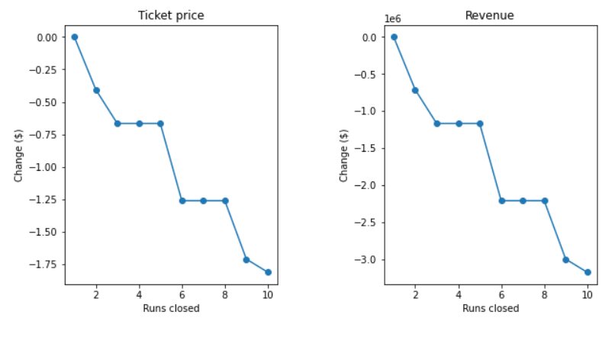
Recommendation & Key Findings
Adding a run, increasing the vertical drop by 150 feet, and installing an additional chair lift can increase support for ticket price by $1.99 and over the season, this could be expected to amount to $3474638.

Slide 4
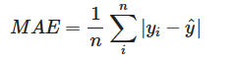
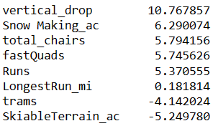
Methodology: Linear Regression Model
Cross-Validation is used to prevent overfitting.
Mean Absolute Error: $11.8
8 features mostly impacts the ticket price

Slide 5
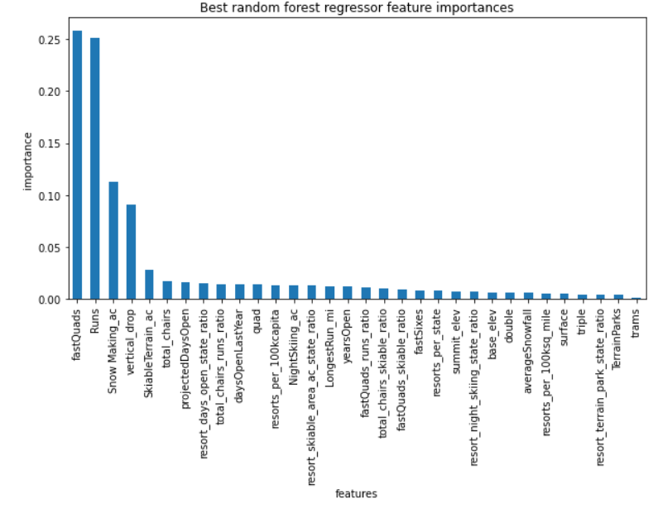
Methodology: Random Forest Model
Cross-Validation is used to prevent overfitting.
Mean Absolute Error: $9.6
4 features mostly impacts the ticket price

Slide 6
Conclusion
The Random Forest Model has lower cross-validation mean absolute error by almost $1.
The prediction error of the ticket price of our best random forest model is $10.39. (Model prediction: $95.87 Actual Price: $81.00)
Adding a run, increasing the vertical drop, and installing an additional chair lift can increase the ticket price.
Adding the total area covered by snow making machines in the acres or the length of the longest run in the resort cannot help improving the price or revenue.

